Slide 1

Keys of UAV technology
Isaac Bassas
Joan Manel Gallart
La Salle Tarragona

Slide 2
Index
Introduction
Interviews
My own drone
About drones
Conclusions

Slide 3
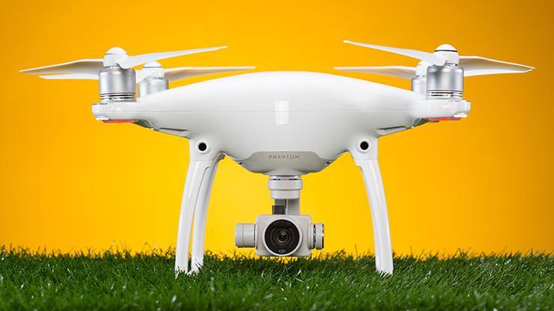
Introduction
Why did I choose this topic?
I just love it
My future studies
Objectives
Learn how drones work
Improve my flying skills
Drone promotion
Promote drone usage

Slide 4
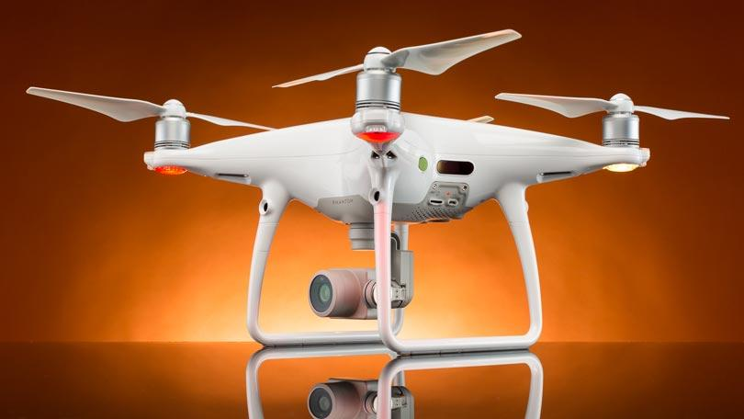
About Drones
Research part

Slide 5
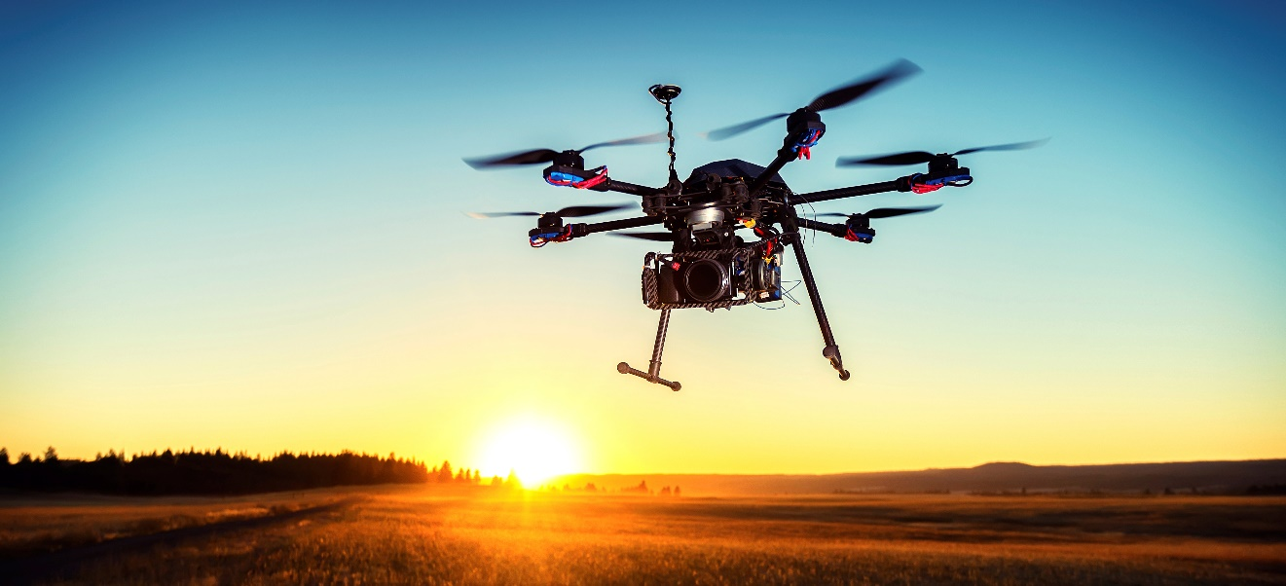
What is a UAV?
A drone, or UAV, is an Unmaned Aerial Vehicle, or, in other words, an aircraft which can be remotely piloted

Slide 6





Benefits over more traditional tools
Faster
Easier to use
Durable and realiable
Cheaper
Safer

Slide 7
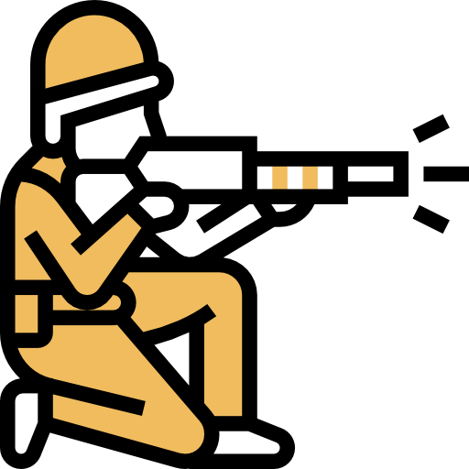



What are drones used for?
Military purposes
Combat
Surveillance
Data gathering
Crop control
Damage control
Real state companies
Transport
Product delivery
Ambulance drones
Taxi drones
Ludic
RC Toys
Racing
Photography

Slide 8
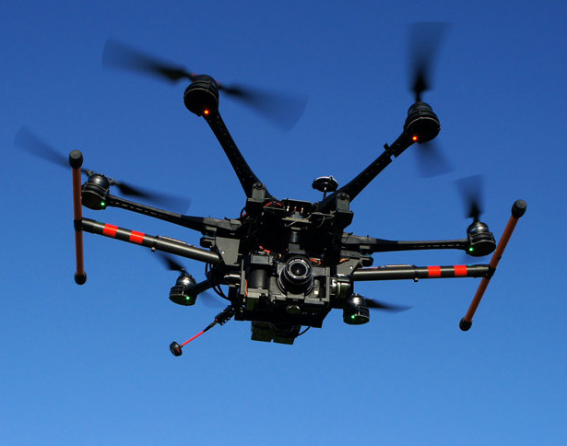
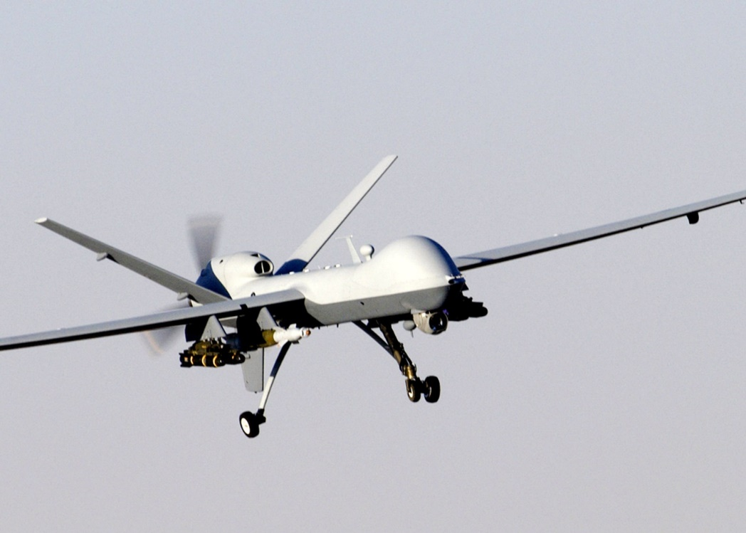
Some real examples of drones
DJI Matrice 600
Used for professional photography
GA MQ-Reaper
Combat and surveillance

Slide 9
Interviews
Practical part

Slide 10
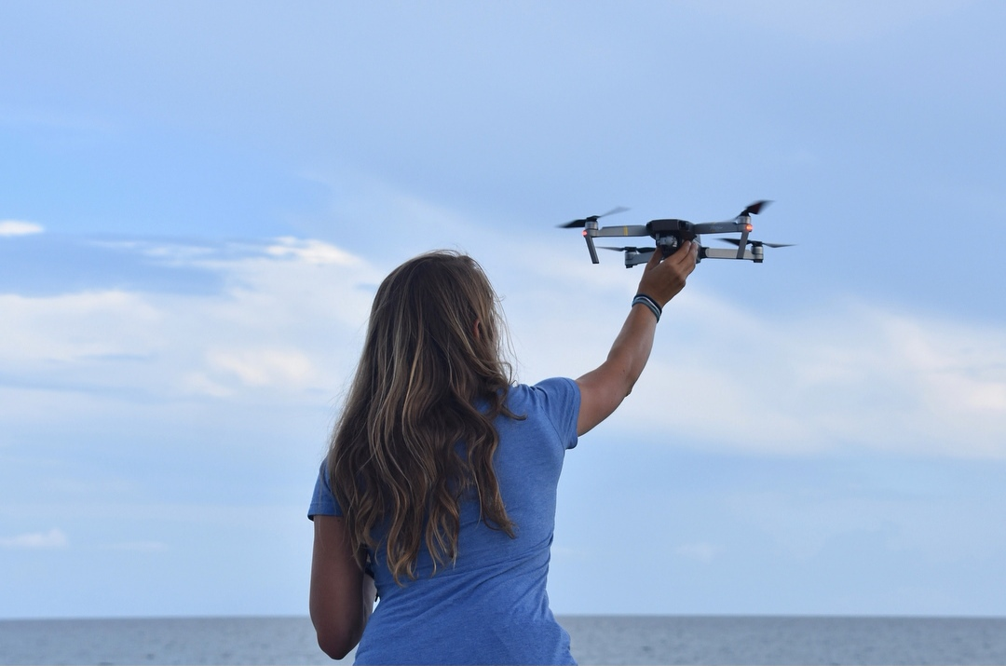
Liah McPhearon
She is a marine biologist who has been monitoring and studing dolphin behaviour using a DJI drone.
“Drones are a great tool to research and monitor animal behaviour”

Slide 11

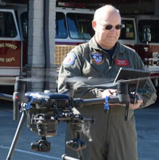
Steve Rhode
He is the chief pilot at Wake Forest Fire Department. He uses drones to identify and gather data about fires.
“Sooner than you might think, computer programmers may become the real heroes of drone rescue”

Slide 12
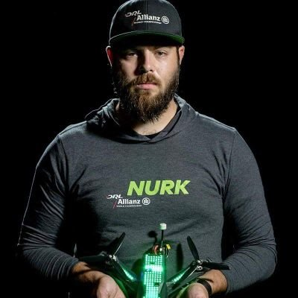
NurkFPV
He is a professional racing drone pilot and last year’s (2018) world champion.
“I started in January 2015, the only hobby I had at the time was motorcycles and something felt missing. So when I found this, it looked fun. Now I just can’t stop flying”

Slide 13
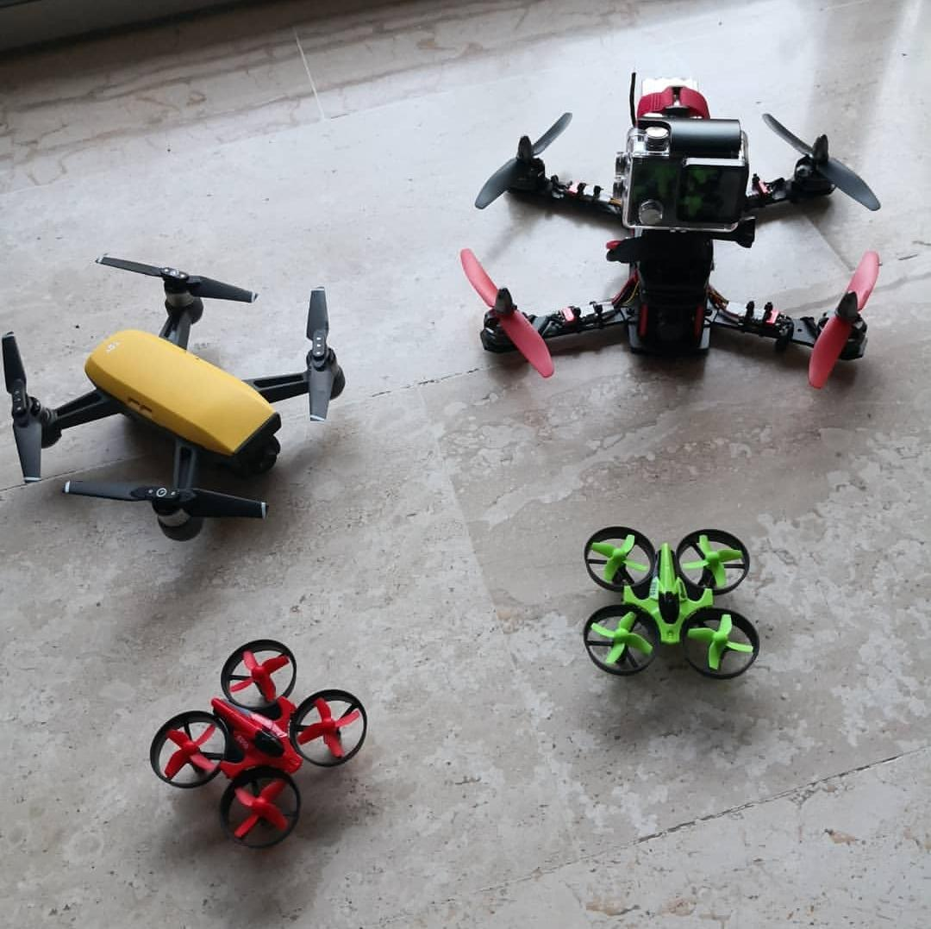
My own drone
Practical part

Slide 14
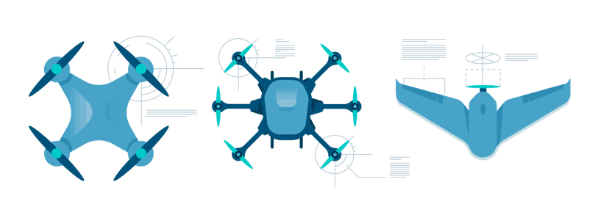
Decide type of drone and intended usage
1
Drone types
Fixed wing
Multirotor
Drone uses
Racing
Photography

Slide 15
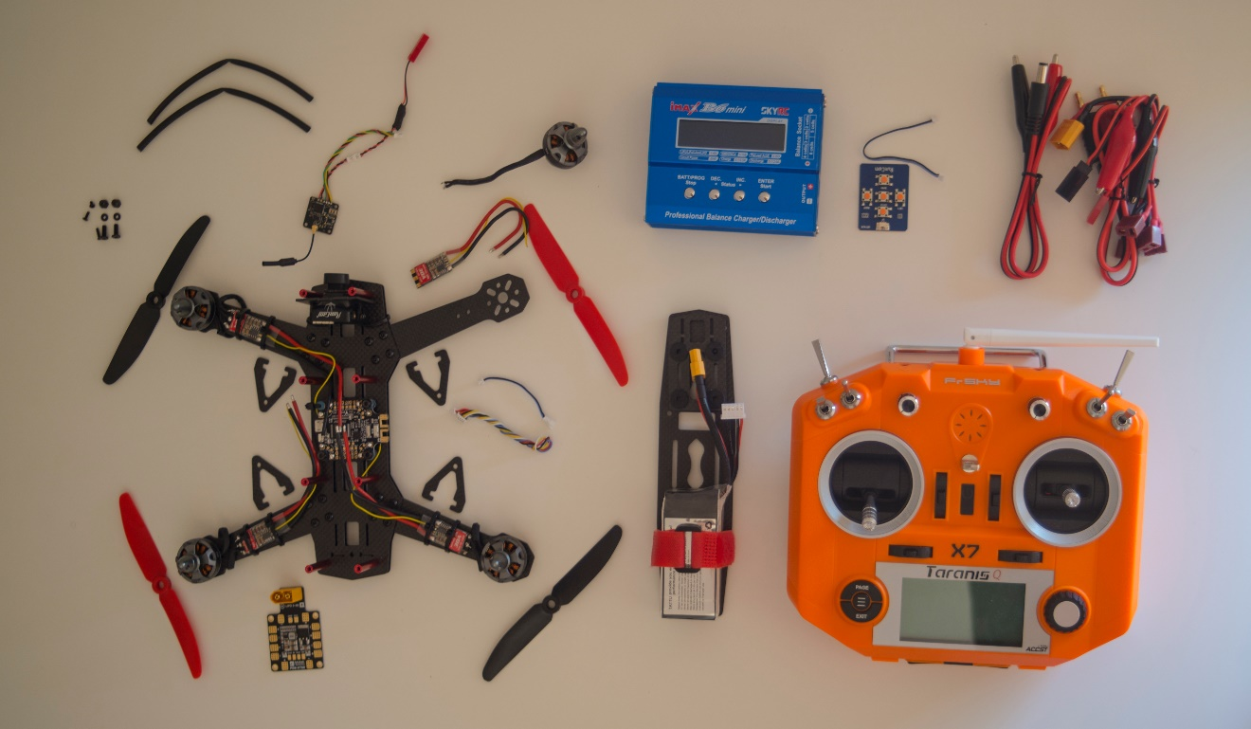
Check the Internet and read lots of reviews
2
Reviews
Discussion boards
Youtube tests
Blogs

Slide 16
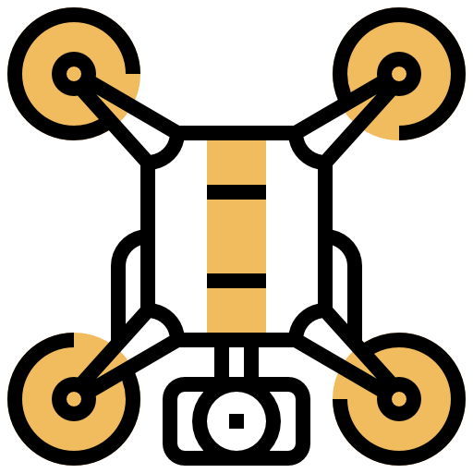

Test each part by yourself
3
Testing the parts yourself
Bench tests
Trial and error

Slide 17
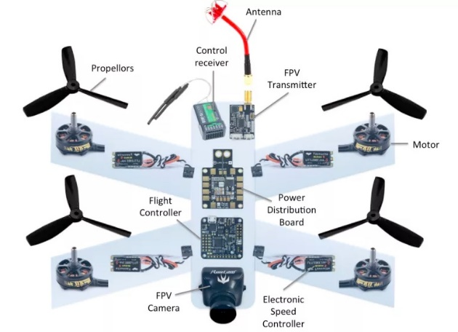
Always plan it
4
Where is everything placed?
Organizing components
Make drafts
CAD
Never tight anything or use permanent glue until you are sure the drone is working

Slide 18
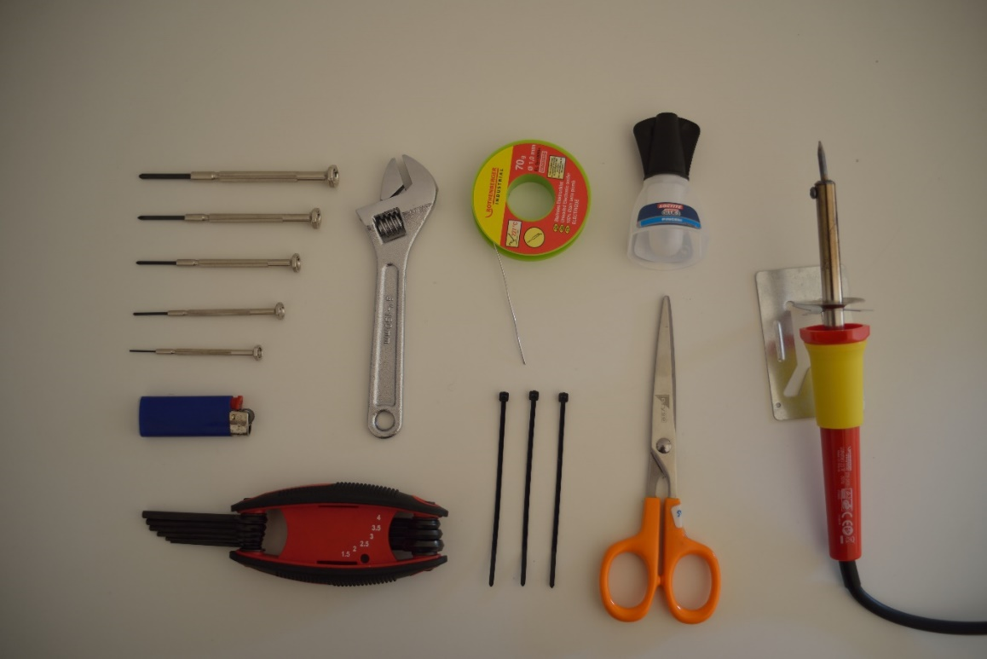
Use appropriate tools
5
How is everything attached together?
Screws
Zip ties
Glue
How are components connected?
Soldering
Heat shrink

Slide 19
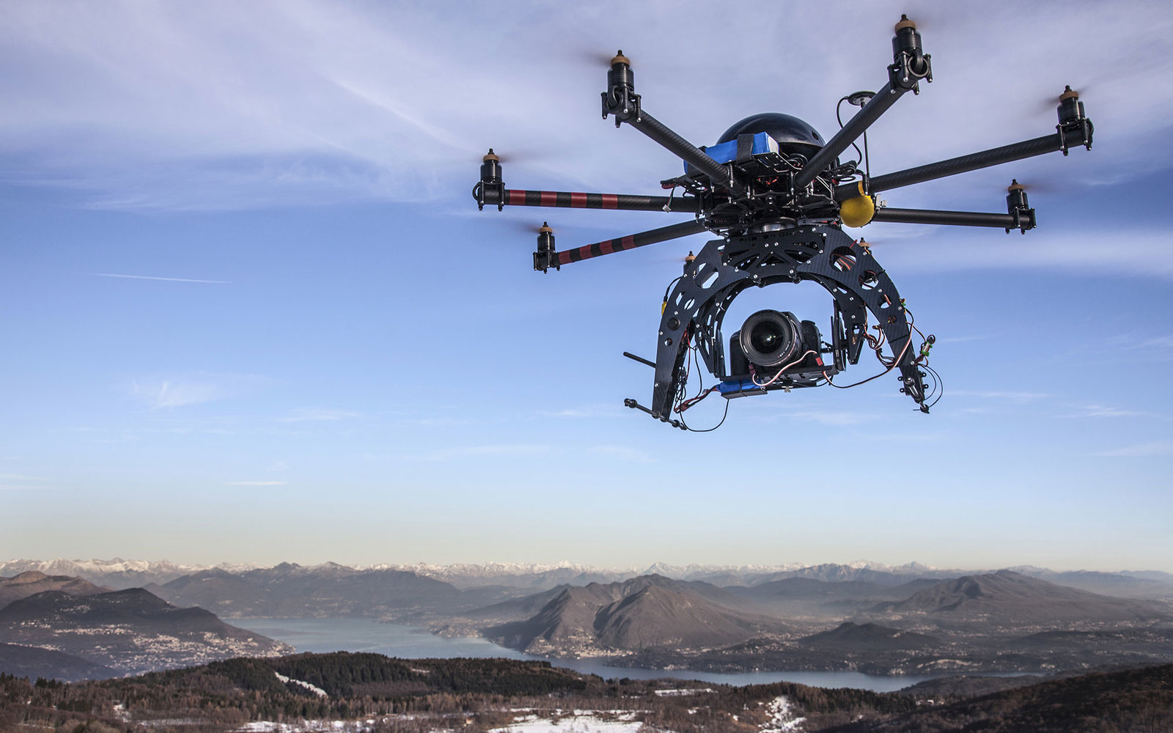
Betaflight: Flight modes
Angle: Remains level without stick input. Pitch and roll is limited to a particular angle and the drone will not flip.
Horizon: Remains level without stick input. Pitch and roll is not fully limited and the drone will allow for flips.
Acro: Requires stick input to manually return the drone to level with the horizon. Pitch and roll inputs determine how fast the drone will rotate on the axis.

Slide 20
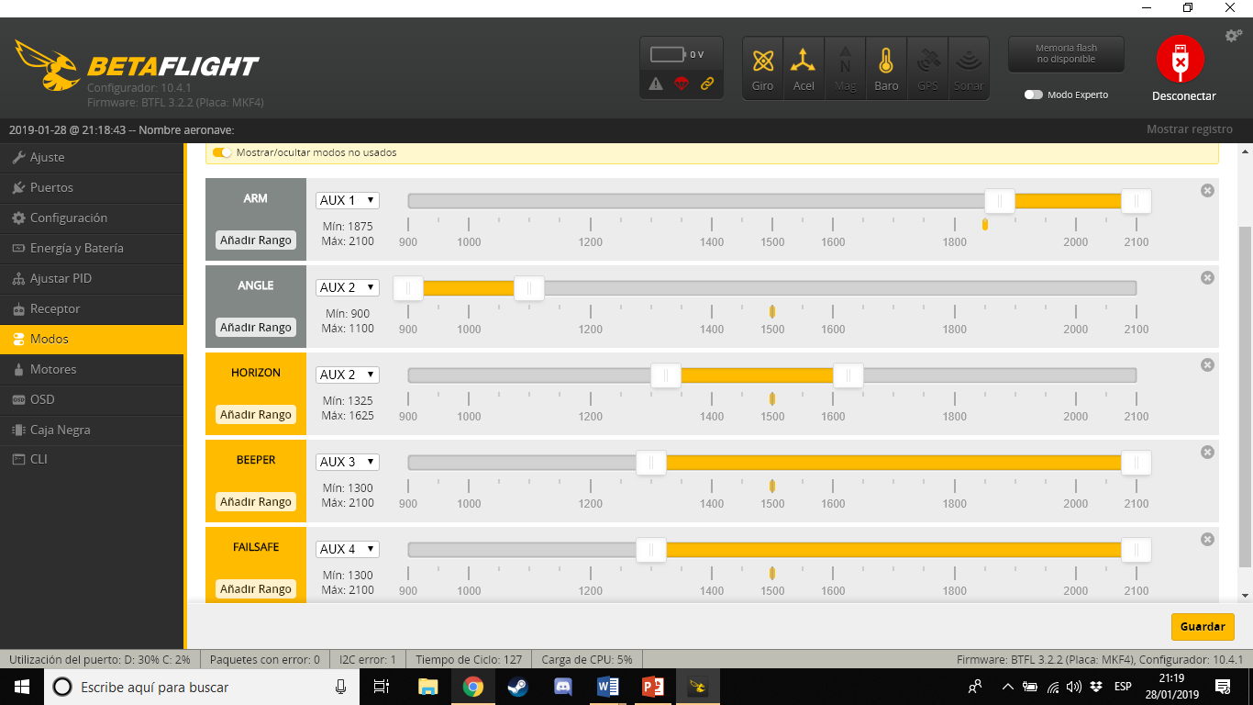
Betaflight: Security modes
Failsafe
What will the drone do in case…
It unbinds
It crashes
Beeper
In case the drone gets lost
Blackbox

Slide 21
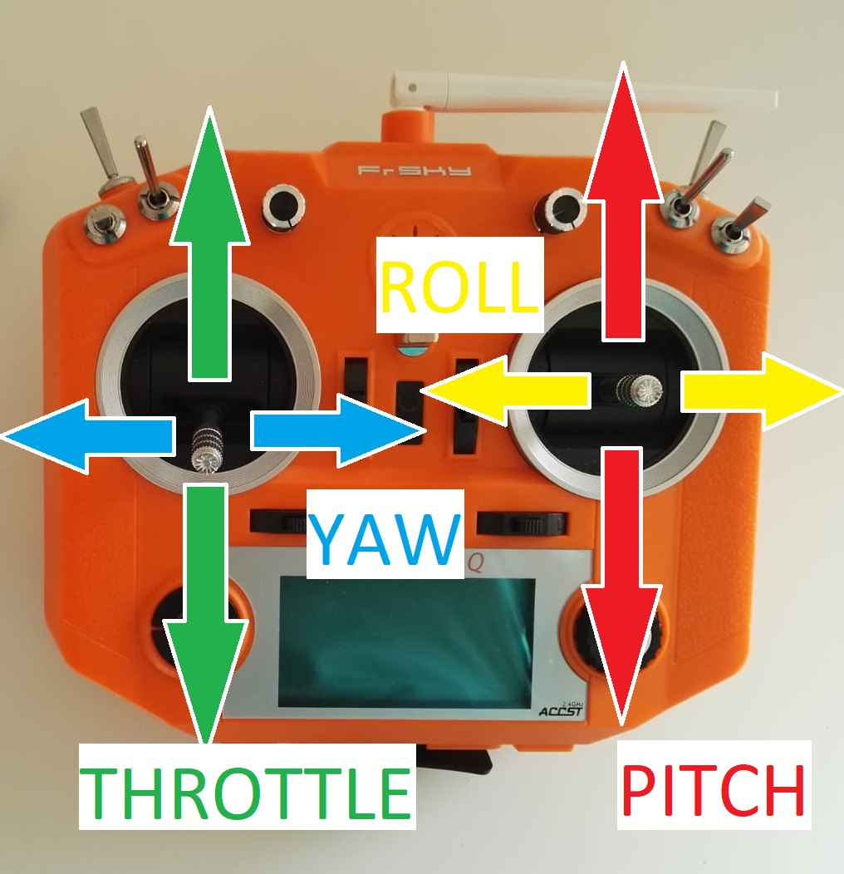
How is it piloted?
Throtle: Up and down motion
Yaw: Clockwise and counterclockwise motion
Pitch: Forward and backward motion
Roll: Left and right motion

Slide 22
Specifications
Data calculated with components specs
Data gathered in bench tests
Thrust
Range
Speed
Drone Specs
Drone Dimensions | 250mm
Thrust (4S battery, 5030) | 3000g*
Thrust (3S battery, 5030) | 2000g*
Motor RPM (4s battery) | 38,640 rpm
Motor RPM (3s battery) | 28,98 rpm
Range | 1.5km*
Drone speed | 100kmh*
Weight (without camera) | 472g
Weight (with camera) | 671g

Slide 23
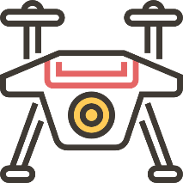
Conclusions

Slide 24

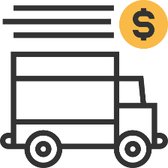






Drones are ALREADY being used for many applications, for both the public and the private sector
Transport
Delivey
Military
Agriculture
AND MUCH MORE…
Data gathering
Leisure
Sea rescue
Wild life research

Slide 25
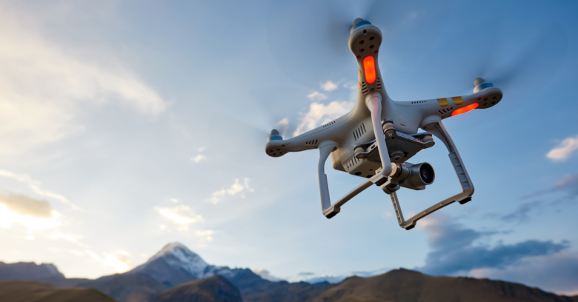
Although many uses are still being tested, great BENEFFITS have arised, and many more are about to come
STILL MUCH TO DISCOVER

Slide 26
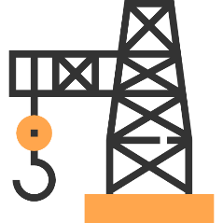





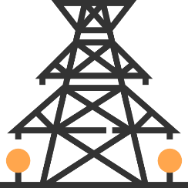

In the NEAR future drones will be integrated in many more sectors
Industry
Aerospace
Crops
Construction
FUTURE IS HERE!
Travel
Mapping
Utilities
Online sales

Slide 27
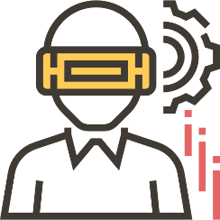



There is starting to be a HUGE demand for drone professionals
Pilots
Engineers
Programmers
Industrial designers
WORK WILL CHANGE
Drones are growing as a carreer in many fields and there is many people alredy living from this

Slide 28
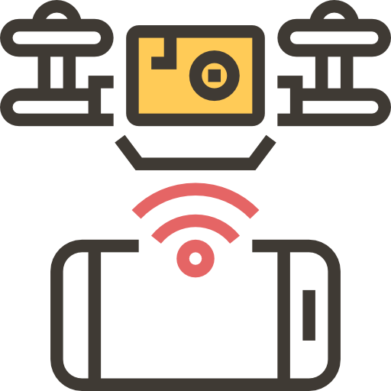
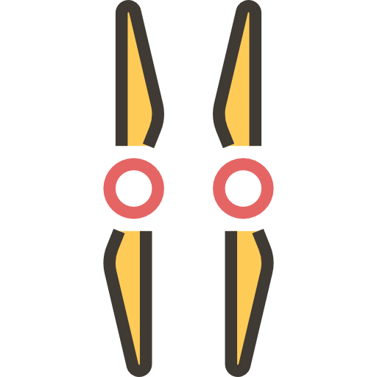
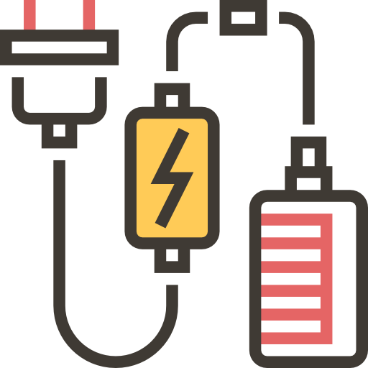
Building a drone is the best way to LEARN how all the components work, and how they interact between each other
HANDS ON!

Slide 29

Start CHECKING all the information available, TALK with professionals on the field and TEST components individually.
TRUST YOUR PEERS
Make sure the choosen parts are the most suitable ones for our drone

Slide 30
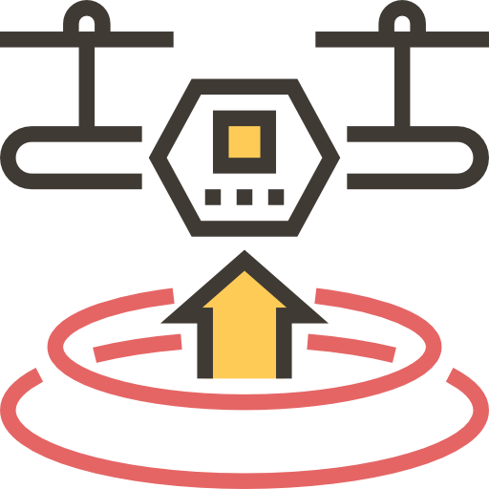
Before building the drone, we must PLAN where we are going to place all the components by using tools like cad or drafts
NOT PLANNING IS RISKY
Doing so is the key to minimize errors and mistakes

Slide 31
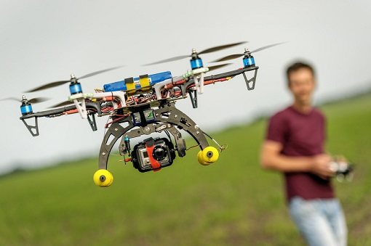
Thank you!

Slide 32
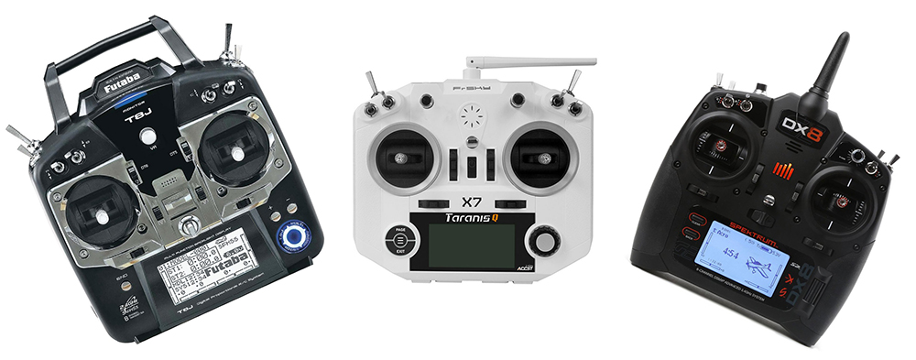
Racing
https://www.youtube.com/watch?v=GTifvVZBNWs
Freestyle
https://www.youtube.com/watch?v=BfO3oUum-hY

